Slide 1
Assignment deadlines reminder
15% - Hot topic study journal – 3 tasks
Task 1 – March 26th
Task 2 – April 2nd
Task 3 – April 9th
10% - Exercises - Case study – April 16th

Slide 2
Hot topic study – 15% → Task 3 (5%)
Find information online about the challenges/difficulties of applying service orientation in the chosen domain/industry
List the most common challenges in a table
challenges | Short description of the challenge | Link to the website where the challenge is described/mentioned

Slide 3
COMP3017 Service Computing

Slide 4
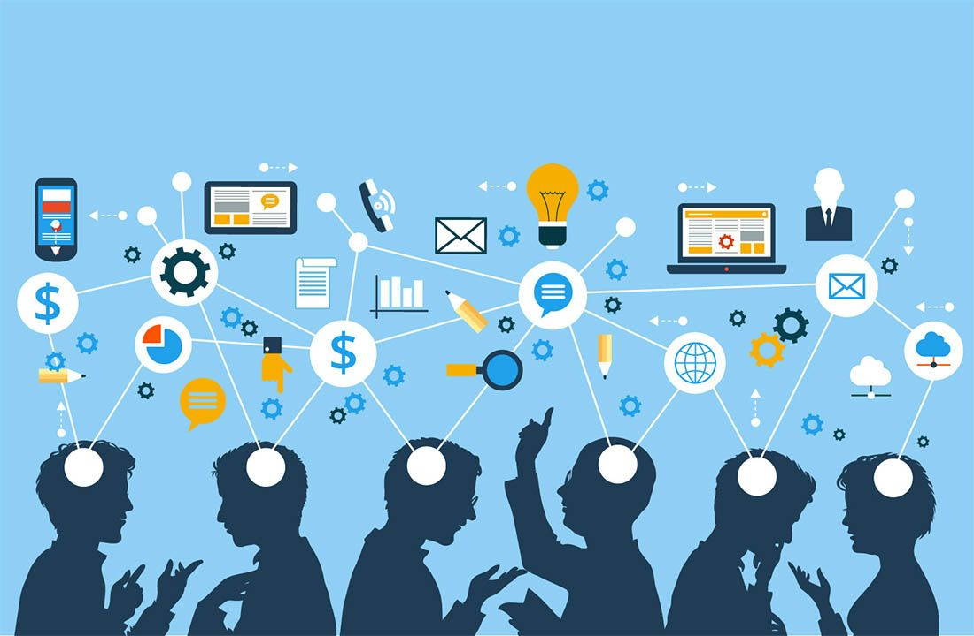
Module Seven: Hot topics in Service Computing - Cloud -

Slide 5
Types of private clouds
Virtual
Hosted
Managed
On-premise/Internal
All private clouds offer an isolated environment
Different types of private clouds are classified into categories based on how they are hosted and how much management they receive from the provider

Slide 6
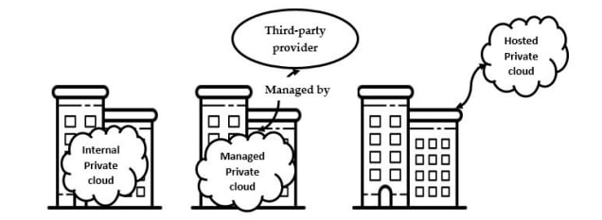
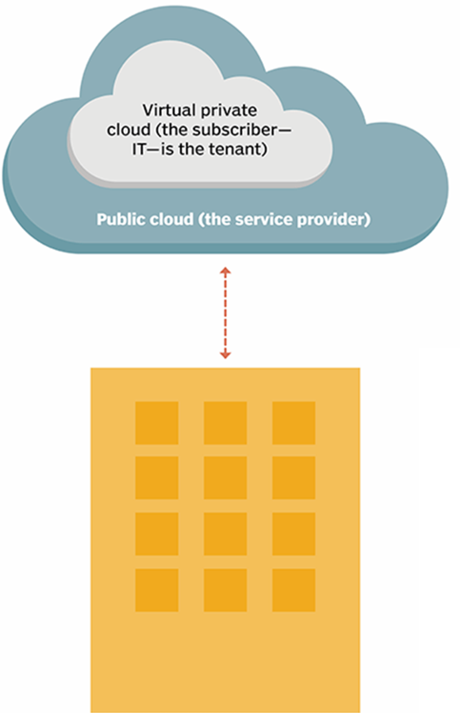
Private cloud types

Slide 7
Types of private clouds

Slide 8
Constructing a private cloud
Cloud infrastructure
components needed for cloud computing
the basic elements of cloud infrastructure are the same whether you have a private cloud, public cloud, or hybrid cloud.
Operating system+ a variety of bare-metal, virtualization, or container software that abstract, pool, and share scalable resources across a network.
The IT staff that is equipped to manage private cloud environments

Slide 9
Private cloud - a virtualized pool of resources
To enable multiple workloads to run on the same physical server, we need to virtualize the resources
We will use virtualization software to achieve that

Slide 10
Example - setting up a virtual machine server

Slide 11
Private Cloud Solutions
Allow companies to architect a data center using software-defined networking (SDN) and virtualization (VMs)
Private cloud solutions come from
proprietary software developers like Microsoft, VMware, and Nutanix
enterprise-grade open source solutions available from Red Hat and others

Slide 12
VMware Private Cloud
VMware - a leading international cloud infrastructure company
provides virtualization solutions since 1998
VMware Private cloud - a virtualized pool of resources allocated on-demand
Private cloud is able to easily switch between virtual machines to keep everything running
It can also create endless virtual machines based on your underlying hardware

Slide 13
VMware vSphere®
Uses virtualization to transform data centers into simplified cloud computing infrastructures

Slide 14
VMware vSphere®
The two core components
VMware ESXi™
The hypervisor on which you create and run virtual machines
VMware vCenter Server®
A service that acts as a central administrator for ESXi hosts that are connected on a network

Slide 15
Physical Topology of vSphere Data Center
A typical VMware vSphere data center consists of physical building blocks such as
x86 virtualization servers - ESXi Hosts
storage networks and arrays
IP networks
a management server - vCenter Server
desktop clients

Slide 16
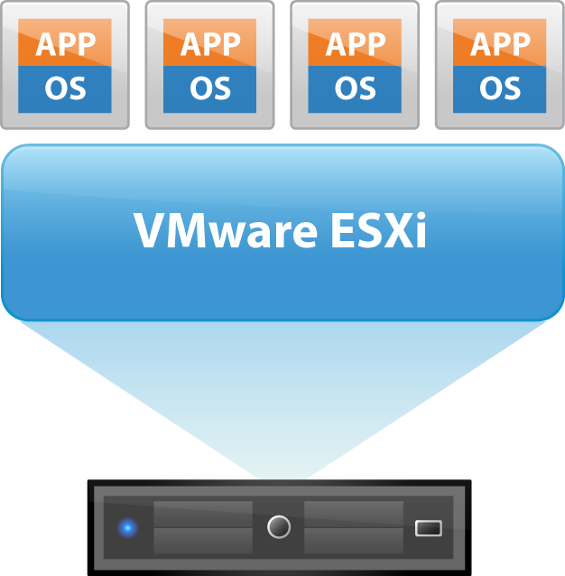
ESXi - the hypervisor in a vSphere environment
Installed on physical or virtual hardware in a virtualized data center, and acts as a platform for virtual machines
Provides physical hardware resources dynamically to virtual machines to support the operation of the virtual machines
Allows virtual machines to operate with a degree of independence from the underlying physical hardware
For example, a virtual machine can be moved from one physical host to another, or its virtual disks can be moved from one type of storage to another, without affecting the functioning of the virtual machine

Slide 17
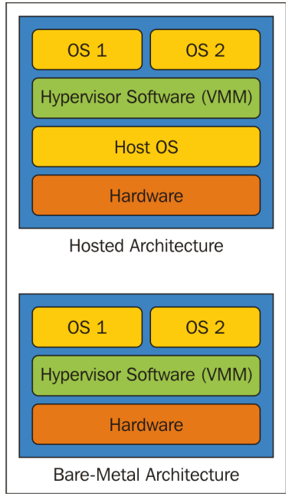
Hypervisor types

Slide 18
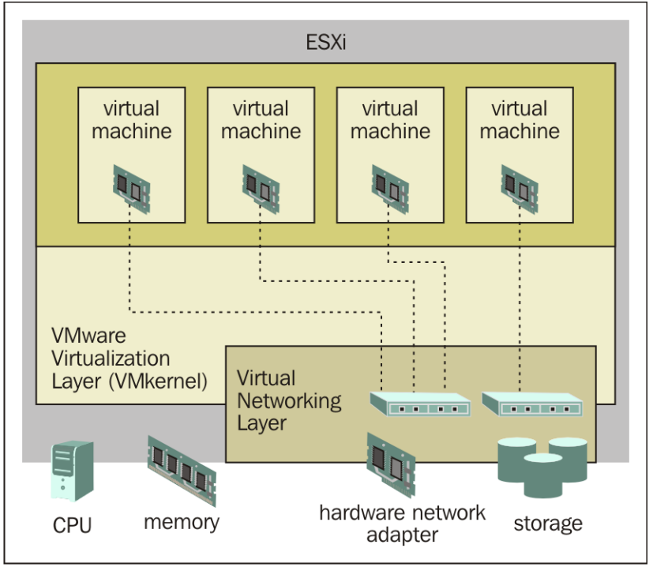
ESXi
An enterprise-class, type-1 hypervisor (bare-metal)
As a type-1 hypervisor, ESXi is not a software application that is installed on an operating system (OS)
Instead, it includes and integrates vital OS components, such as a kernel

Slide 19
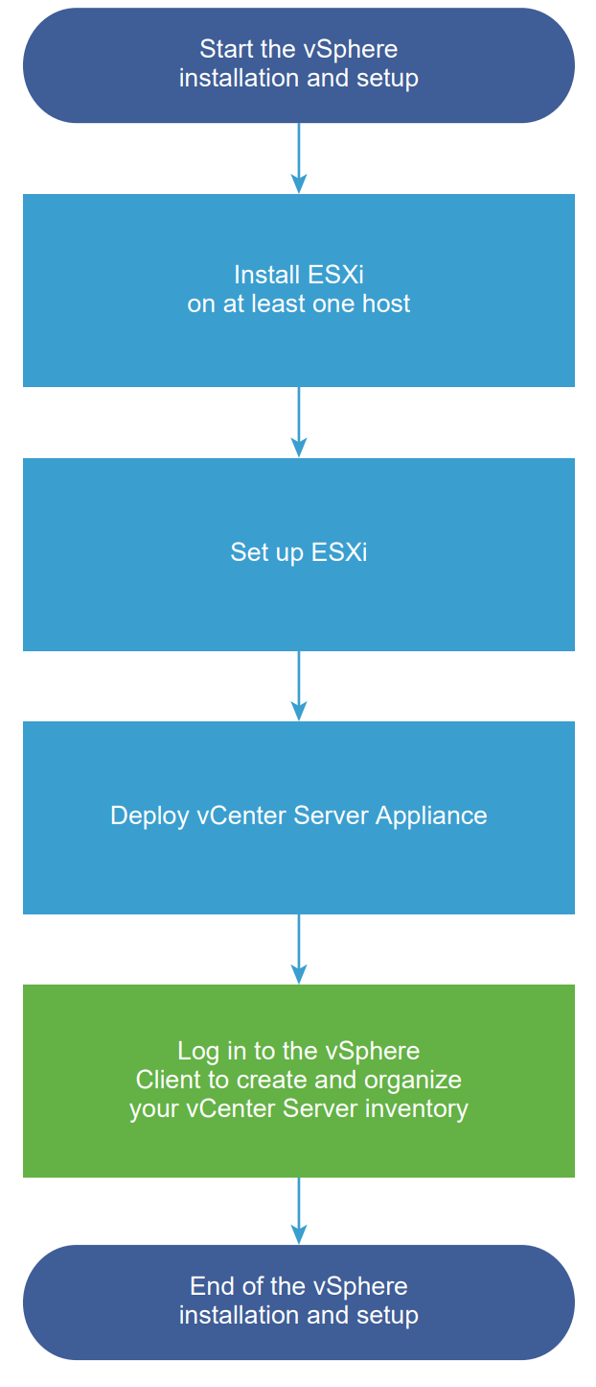
VSphere installation and setup
You can install and set up ESXi on your physical hardware so that it acts as a platform for virtual machines
After ESXi is installed and set up, you can manage the host by using the vSphere Client and vCenter Server, license the host, and back up your ESXi configuration
You can also use the VMware Host Client to connect directly to the ESXi host and to manage it

Slide 20
The vCenter Server appliance
The vCenter Server appliance is a preconfigured virtual machine that is optimized for running vCenter Server and the associated services

Slide 21



vCenter Server (1)
vCenter Server provides a single point of control to the data center
You can pool and manage the resources of multiple hosts
It unifies the resources from the individual computing servers to be shared among virtual machines in the entire data center
It provides essential data center services such as
Access control
Performance monitoring
Configuration
VMware vCenter Server

Slide 22
vCenter Server (2)
Allows you to monitor and manage your physical and virtual infrastructure
It manages the assignment of virtual machines to the ESXi hosts and the assignment of resources to the virtual machines within a given computing server
These assignments are based on the policies that the system administrator sets
VMware vCenter Server

Slide 23
vCenter Server (3)
A single point of control doesn’t mean a single point of failure
Compute servers continue to function even if vCenter Server becomes unreachable (for example, if the network is severed)
The ESXi hosts can be managed separately and continue to run the virtual machines assigned to them based on the resource assignment that was last set
After connection to vCenter Server is restored, it can manage the data center as a whole again
VMware vCenter Server

Slide 24
Constructing a private cloud
Cloud infrastructure
components needed for cloud computing
the basic elements of cloud infrastructure are the same whether you have a private cloud, public cloud, or hybrid cloud
Operating system+ a variety of bare-metal, virtualization, or container software that abstract, pool, and share scalable resources across a network
The IT staff that is equipped to manage private cloud environments

Slide 25
Cloud engineering professionals
Cloud engineer
Cloud architect

Slide 26
Cloud architect role
Creating a well-informed cloud strategy and managing the adaptation process
Evaluating cloud applications, hardware, and software
Designing and implementing cloud computing solutions
designing the cloud infrastructure
designing the cloud application architecture
designing the cloud security architecture

Slide 27
Cloud professionals key skills
Know the language of business and domain knowledge
Understand the conceptual, logical and physical architecture
Master various cloud technologies, frameworks, and platforms
Implement the solutions for quality of cloud services
Work on the security at multiple levels
Develop applications for flexible deployment, provisioning, and management
Leverage open source packages and products
Apply agile and lean principles in design and construction

Slide 28
Cloud professionals technical skills
Good knowledge of at least one operating system
Linux, Unix, Solaris, Ubuntu, Windows
Good understanding of networking
TCP/IP, IP addresses, HTTP, DNS
Computer programming languages
at least a minimal understanding of a programming or scripting language (helpful)
Security
a high-level understanding of key security concepts, initial knowledge of some basic security concepts, such as firewalls

Slide 29
Certified Cloud Architect - AWS
AWS Certified Solutions Architect – Associate
This certification validates technical expertise in designing and deploying systems on the AWS platform

Slide 30
Certified Cloud Architect – Microsoft Azure
Microsoft Azure Solutions Architect
The certification requires expertise in compute, network, storage, and security to design solutions that run on Azure
Two exams:
AZ-300 Exam: Technologies for Microsoft Azure Architects
AZ-301 Exam: Designing a Microsoft Azure Architecture

Slide 31
Choosing cloud deployments
Public cloud?
Private cloud?
Hybrid cloud?

Slide 32
Making the choice to adopt private cloud
Choosing private cloud over public mainly boils down to two things
budgeting (choosing CAPEX over OPEX)
control (in terms of security and privacy)

Slide 33
Budgeting
Capital Expenditures (CapEx)
Purchases of significant goods or services that will be used to improve a company’s performance in the future
Manufacturing plants, equipment, and machinery
Building improvements
Computers
Vehicles and trucks
…
Operating Expenses (OpEx)
The costs that a company incurs for running its day-to-day operations
Rent and utilities
Wages and salaries
…

Slide 34
Budgeting issues
Which cloud costs more?
You usually pay for what you use in a public cloud, though some public clouds don't charge tenants.
Whoever set up a private cloud is usually responsible for purchasing or renting new hardware and resources to scale up
Hybrid clouds can include any on-premises, off-premises, or provider's cloud to create a custom environment that suits your cost requirements

Slide 35
Budgeting issues
Which cloud has the best resources?
That depends on how you want to spend money. Do you want to incur capital expenses (CapEx) or operating expenses (OpEx)? This is the classic scale-up vs. scale-out question.
Public cloud users seem to have unlimited access to resources, but accessing those resources is usually an operational expense.
Deploying more private cloud resources requires buying or renting more hardware—all capital expenses.
Hybrid clouds give you the option of using operating expenses to scale out or capital expenses to scale up

Slide 36
Control issues
Which cloud is safest?
Public clouds
Tend to have a wider variety of security threats due to multi-tenancy and numerous access points
Often split security responsibilities
infrastructural security can be the provider’s responsibility
workload security can be the tenant's responsibility
Private clouds
Are thought to be more secure because workloads usually run behind the user's firewall
All depends on how strong the user’s own security is
Hybrid cloud
security is made up of the best features of every environment
users and admins can minimize data exposure by moving workloads and data across environments based on compliance, audit, policy, or security requirements

Slide 37
Summary
All private clouds offer an isolated environment but differ on how they are hosted and how much management they receive from the provider
Private clouds are based on the same technologies as public and hybrid clouds
Before adopting cloud technology, companies need to first develop a migration strategy in which they define their needs, expectations, and goals

Slide 38
Topic 6: Problems with cloud computing

Slide 39
Security Issues in Cloud Computing

Slide 40
Intended learning outcomes
After completing this topic, you will be able to:
Present cloud issues/characteristics that create interesting security problems
Identify a few security issues within this framework
Discuss some approaches that address these issues

Slide 41
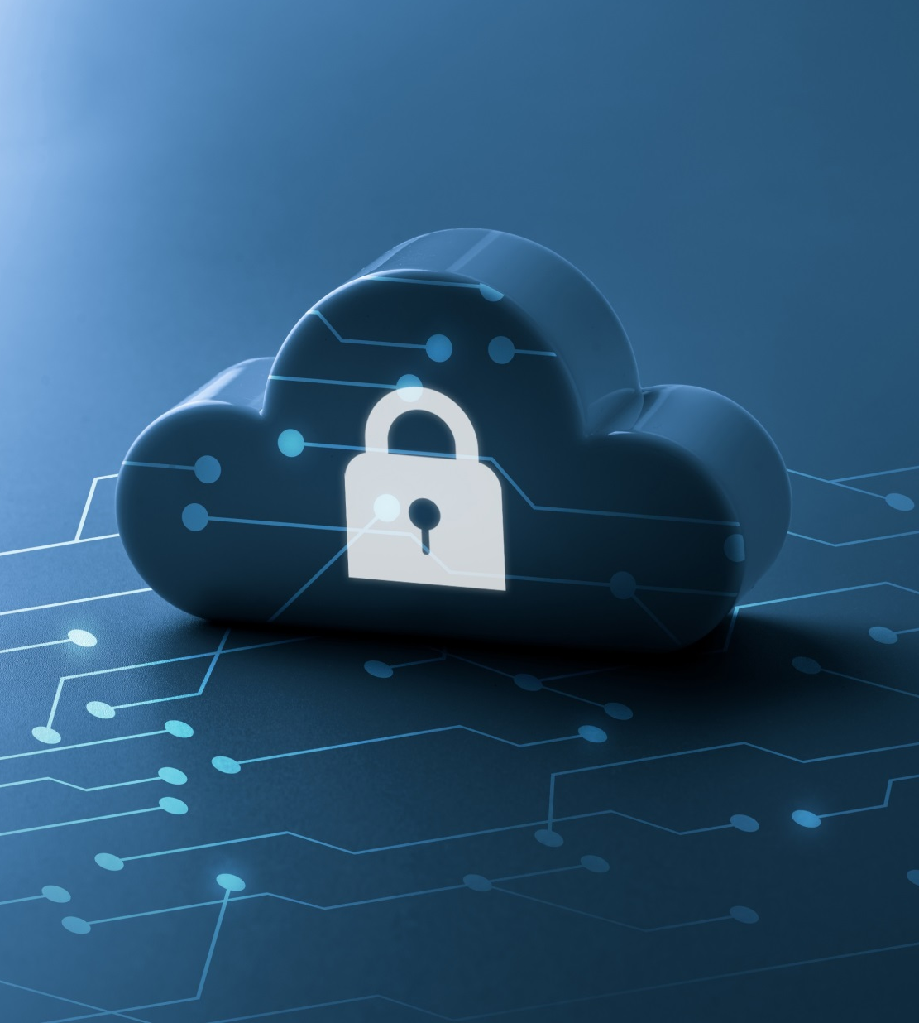
Some Cloud Security Statistics
Security and risk management spending grew 6.4% in 2020
As per a recent study, 79% of enterprises want better integrated security and governance for their data in the cloud

Slide 42
Cloud Computing: A Massive Concentration of Resources
Also a massive concentration of risk
expected loss from a single breach can be significantly larger
concentration of “users” represents a concentration of threats
“Ultimately, you can outsource responsibility but you can’t outsource accountability.”
J. McDermott, (2009) "Security Requirements for Virtualization in Cloud Computing," presented at the ACSAC Cloud Security Workshop, Honolulu, Hawaii, USA, 2009.

Slide 43
Threats & Vulnerabilities
Threat is harm or unauthorized access that might occur due to vulnerability and destroy organization assets, organization operations or system information
Vulnerability is any weakness in information system, system security procedures, internal controls or implementation that could be exploited or triggered by a threat resources

Slide 44
Threats
Data loss or leakage
Denial of service attack
Malicious insider
Data breaches
Abuse of cloud services
Unauthorized access to API
…

Slide 45
Vulnerabilities
Insufficient due diligence
Misconfigured cloud services
Insecure interface
Obsolete cryptography
Insecure VM migration
Internet protocol
Vendor lock-in
…

Slide 46
Real life examples (1)
Malware infections
Malicious software
Cloud Snooper – cloud malware that infected cloud infrastructure servers hosted in the AWS cloud, using sophisticated techniques to evade detection and communicate with its servers through a firewall

Slide 47
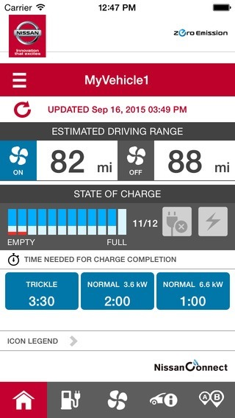
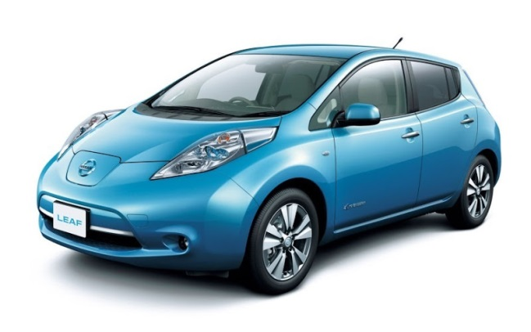
Real life examples (2)
Unauthorized access to API
When developers create APIs with inadequate authentication, they can contain security vulnerabilities that allow anyone to access your corporate data.
Example - Nissan — an API flaw resulted in the ability for hackers to remotely control some features of the Nissan LEAF.

Slide 48
Real life examples (3)
Misconfigured cloud services
A cloud misconfiguration happens when a user or admin fails to properly set a cloud platform’s security setting.
The Alteryx breach in 2017, during which the online marketing firm exposed data from millions of households by misconfiguring an AWS S3 Bucket.

Slide 49
Cloud Computing: who should use it?
Cloud computing definitely makes sense if your own security is weak, missing features, or below average
Ultimately, if
the cloud provider’s security people are “better” than yours (and leveraged at least as efficiently),
the web-services interfaces don’t introduce too many new vulnerabilities, and
the cloud provider aims at least as high as you do, at security goals,
then cloud computing has better security
J. McDermott, (2009) "Security Requirements for Virtualization in Cloud Computing," presented at the ACSAC Cloud Security Workshop, Honolulu, Hawaii, USA, 2009.

Slide 50
Problems Associated with Cloud Computing
Most security problems stem from:
Loss of control
Lack of trust (mechanisms)
Multi-tenancy
These problems exist mainly in 3rd party management models
Self-managed clouds still have security issues, but not related to above
Notes:
50
Data mobility: the abiltiy to share data between cloud services
Where does data reside?
- out-of-state, out-of-country issues
Security Concerns for government in particular
FISMA
How to certify and accredit cloud computing providers under FISMA
(e.g. ISO 27001)

Slide 51
Loss of Control in the Cloud
Consumer’s loss of control
Data, applications, resources are located with provider
User identity management is handled by the cloud
User access control rules, security policies and enforcement are managed by the cloud provider
Consumer relies on provider to ensure
Data security and privacy
Resource availability
Monitoring and repairing of services/resources

Slide 52
Lack of Trust in the Cloud
Need for trust arises only in risky situations
Defunct third party management schemes
Hard to balance trust and risk
Notes:
Chiles and McMakin (1996) define trust as increasing one’s vulnerability to the risk of opportunistic behavior of another whose behavior is not under one’s control in a situation in which the costs of violating the trust are greater than the benefits of upholding the trust.
Trust here means mostly lack of accountability and verifiability

Slide 53
Multi-tenancy Issues in the Cloud
Conflict between tenants’ opposing goals
Tenants share a pool of resources and have opposing goals
How to provide separation between tenants?
Notes:
Who are my neighbors? What is their objective? They present another facet of risk and trust requirements

Slide 54
Security Issues in the Cloud
In theory, minimizing any of the issues would help:
Loss of Control
Take back control
Data and apps may still need to be on the cloud
But can they be managed in some way by the consumer?
Lack of trust
Increase trust (mechanisms)
Technology
Policy, regulation
Multi-tenancy
Private cloud
Takes away the reasons to use a cloud in the first place
VPC: its still not a separate system
Strong separation
Notes:
While VPC providers argue that they provide superior isolation, the fact of the matter is that your data is not a separate physical system: your data is still stored on actual servers along with other consumers’ data, but logically separated. If the actual server fails, your data and applications stored on it are lost. Also, there needs to be a high level of trust as to the degree of isolation provided.

Slide 55
Security Issues in the Cloud
In theory, minimizing any of the issues would help:
Loss of Control
Take back control
Data and apps may still need to be on the cloud
But can they be managed in some way by the consumer?
Lack of trust
Increase trust (mechanisms)
Technology
Policy, regulation → this topic has been studied when we talked about cloud standardization and regulation in China and internationally
Multi-tenancy
Private cloud
Takes away the reasons to use a cloud in the first place
VPC: its still not a separate system
Strong separation
Notes:
While VPC providers argue that they provide superior isolation, the fact of the matter is that your data is not a separate physical system: your data is still stored on actual servers along with other consumers’ data, but logically separated. If the actual server fails, your data and applications stored on it are lost. Also, there needs to be a high level of trust as to the degree of isolation provided.

Slide 56
Minimize Lack of Trust: Policy Language
Create policy language with the following characteristics:
Machine-understandable (or at least processable),
Easy to combine/merge and compare
Examples of policy statements
“requires isolation between VMs”
“requires geographical isolation between VMs”
“requires physical separation between other communities/tenants that are in the same industry,”
Need a validation tool to check that the policy created in the standard language correctly reflects the policy creator’s intentions (i.e. that the policy language is semantically equivalent to the user’s intentions)
Notes:
These SLAs typically state the high level policies of the provider (e.g. Will maintain uptime of 98%) and do not allow cloud consumers to dictate their requirements to the provider. COI clouds in particular have specific security policy requirements that must be met by the provider, due to the nature of COIs and the missions they are used for. These requirements need to be communicated to the provider and the provider needs to provide some way of stating that the requirements can be met. Cloud consumers and providers need a standard way of representing their security requirements and capabilities. Consumers also need a way to verify that the provided infrastructure and its purported security mechanisms meet the requirements stated in the consumer’s policy (proof of assertions). For example, if the consumer’s policy requires isolation of VMs, the provider can create an assertion statement that says it uses cache separation to support VM isolation.

Slide 57
Minimize Lack of Trust: Certification
Certification
Some form of reputable, independent, comparable assessment and description of security features and assurance
Risk assessment
Performed by certified third parties
Provides consumers with additional assurance

Slide 58
Minimize Loss of Control in the Cloud
Monitoring
Utilizing different clouds
Access control management

Slide 59
Minimize Loss of Control: Monitoring (1)
Cloud consumer needs situational awareness for critical applications
When underlying components fail, what is the effect of the failure to the mission logic
What recovery measures can be taken (by provider and consumer)
Notes:
When the underlying components fail in the cloud, the effect of the failures to the mission logic needs to be known so that correct recovery measures can be performed. We propose an application-specific run-time monitoring and management tool. With this tool, the application logic can remain on the consumer’s host computer. This allows the consumer to centrally monitor all aspects of the application as well as data flow. Since all outputs from underlying services are sent to the application logic, any data incompatibility between services is not an issue. The capabilities of the run-time monitoring and management tool are as follows: 1) Enable application user to determine the status of the cloud resources that may be used to run the application (across multiple clouds), 2) Enable application user to determine the real-time security posture and situational awareness of the application, 3) Provide the application user with the ability to move user’s application (or part of it) to another site (other VM in same cloud or different cloud altogether), 4) Provide the application user with the ability to change the application logic on the fly, 5) Provide communicate capabilities with cloud providers. There are a few cloud vendors such as NimSoft [41] and Hyperic [42] that provide application-specific monitoring tools that provide some of the above functionality. These monitoring tools may be further enhanced or used in conjunction with other tools to provide the degree of monitoring required. However, any tool that is to be used for military purposes must also receive some type of accreditation and certification procedure.

Slide 60
Minimize Loss of Control: Monitoring (2)
Requires an application-specific run-time monitoring and management tool for the consumer
The cloud consumer and cloud provider have different views of the system
Enable both the provider and tenants to monitor the components in the cloud that are under their control
Provide mechanisms that enable the provider to act on attacks he can handle
Provide mechanisms that enable the consumer to act on attacks that he can handle (application-level monitoring)
Notes:
When the underlying components fail in the cloud, the effect of the failures to the mission logic needs to be known so that correct recovery measures can be performed. We propose an application-specific run-time monitoring and management tool. With this tool, the application logic can remain on the consumer’s host computer. This allows the consumer to centrally monitor all aspects of the application as well as data flow. Since all outputs from underlying services are sent to the application logic, any data incompatibility between services is not an issue. The capabilities of the run-time monitoring and management tool are as follows: 1) Enable application user to determine the status of the cloud resources that may be used to run the application (across multiple clouds), 2) Enable application user to determine the real-time security posture and situational awareness of the application, 3) Provide the application user with the ability to move user’s application (or part of it) to another site (other VM in same cloud or different cloud altogether), 4) Provide the application user with the ability to change the application logic on the fly, 5) Provide communicate capabilities with cloud providers. There are a few cloud vendors such as NimSoft [41] and Hyperic [42] that provide application-specific monitoring tools that provide some of the above functionality. These monitoring tools may be further enhanced or used in conjunction with other tools to provide the degree of monitoring required. However, any tool that is to be used for military purposes must also receive some type of accreditation and certification procedure.

Slide 61
Minimize Loss of Control: Utilize Different Clouds
The concept of ‘Don’t put all your eggs in one basket’
Consumer may use services from different clouds through an intra-cloud or multi-cloud architecture
A multi-cloud or intra-cloud architecture in which consumers
Spread the risk
Increase redundancy (per-task or per-application)
Increase chance of mission completion for critical applications
Notes:
Differering data semantics example: does a data item labeld secret in one cloud have the same semantics as another piece of data also labeled secret in a different cliud?

Slide 62
Minimize Loss of Control: Utilize Different Clouds
Possible issues to consider:
Policy incompatibility (combined, what is the overarching policy?)
Data dependency between clouds
Differing data semantics across clouds
Knowing when to utilize the redundancy feature (monitoring technology)
Is it worth it to spread your sensitive data across multiple clouds?
Redundancy could increase risk of exposure
Notes:
Differering data semantics example: does a data item labeld secret in one cloud have the same semantics as another piece of data also labeled secret in a different cliud?

Slide 63
Minimize Loss of Control: Access Control (1)
Many possible layers of access control
E.g. access to the cloud, access to servers, access to services, access to databases (direct and queries via web services), access to VMs, and access to objects within a VM
Depending on the deployment model used, some of these will be controlled by the provider and others by the consumer
Notes:
In cloud computing (as well as other systems), there are many possible layers of access control. For example, access to the cloud, access to servers, access to services, access to databases (direct and queries via web services), access to VMs, and access to objects within a VM. Depending on the deployment model used, some of these will be controlled by the provider and others by the consumer.
For example, Google Apps, a representative SaaS Cloud controls authentication and access to its applications, but users themselves can control access to their documents through the provided interface to the access control mechanism. In IaaS type approaches, the user can create accounts on its virtual machines and create access control lists for these users for services located on the VM.
Regardless of the deployment model, the provider needs to manage the user authentication and access control procedures (to the cloud). While some providers allow federated authentication – enabling the consumer-side to manage its users, the access control management burden still lies with the provider. This requires the user to place a large amount of trust on the provider in terms of security, management, and maintenance of access control policies. This can be burdensome when numerous users from different organizations with different access control policies, are involved. This proposal focuses on access control to the cloud. However, the concepts here could be applied to access control at any level, if deemed necessary. We propose a way for the consumer to manage the access control decision-making process to retain some control, requiring less trust of the provider.
Approach:
This approach requires the client and provider to have a pre-existing trust relationship, as well as a pre-negotiated standard way of describing resources, users, and access decisions between the cloud provider and consumer. It also needs to be able to guarantee that the provider will uphold the consumer-side’s access decisions. Furthermore, we need to show that this approach is at least as secure as the traditional access control model.
This approach requires the data owner to be involved in all requests. Therefore, frequent access scenarios should not use this method if traffic is a concern. However, many secure data outsourcing schemes require the user to grant keys/certificates to the query side, so that every time the user queries a database, the owner needs to be involved. Therefore, not much different than that so may not be a problem.

Slide 64
Minimize Loss of Control: Access Control (2)
Regardless of deployment model, provider needs to manage the user authentication and access control procedures (to the cloud)
Federated Identity Management: access control management burden still lies with the provider
Requires user to place a large amount of trust on the provider in terms of security, management, and maintenance of access control policies. This can be burdensome when numerous users from different organizations with different access control policies, are involved
Notes:
In cloud computing (as well as other systems), there are many possible layers of access control. For example, access to the cloud, access to servers, access to services, access to databases (direct and queries via web services), access to VMs, and access to objects within a VM. Depending on the deployment model used, some of these will be controlled by the provider and others by the consumer.
For example, Google Apps, a representative SaaS Cloud controls authentication and access to its applications, but users themselves can control access to their documents through the provided interface to the access control mechanism. In IaaS type approaches, the user can create accounts on its virtual machines and create access control lists for these users for services located on the VM.
Regardless of the deployment model, the provider needs to manage the user authentication and access control procedures (to the cloud). While some providers allow federated authentication – enabling the consumer-side to manage its users, the access control management burden still lies with the provider. This requires the user to place a large amount of trust on the provider in terms of security, management, and maintenance of access control policies. This can be burdensome when numerous users from different organizations with different access control policies, are involved. This proposal focuses on access control to the cloud. However, the concepts here could be applied to access control at any level, if deemed necessary. We propose a way for the consumer to manage the access control decision-making process to retain some control, requiring less trust of the provider.
Approach:
This approach requires the client and provider to have a pre-existing trust relationship, as well as a pre-negotiated standard way of describing resources, users, and access decisions between the cloud provider and consumer. It also needs to be able to guarantee that the provider will uphold the consumer-side’s access decisions. Furthermore, we need to show that this approach is at least as secure as the traditional access control model.
This approach requires the data owner to be involved in all requests. Therefore, frequent access scenarios should not use this method if traffic is a concern. However, many secure data outsourcing schemes require the user to grant keys/certificates to the query side, so that every time the user queries a database, the owner needs to be involved. Therefore, not much different than that so may not be a problem.

Slide 65
Minimize Multi-tenancy in the Cloud
Can’t really force the provider to accept less tenants
Can try to increase isolation between tenants
Strong isolation techniques (VPC to some degree)
QoS requirements need to be met
Policy specification
Can try to increase trust in the tenants
Who’s the insider, where’s the security boundary? Who can I trust?
Use SLAs to enforce trusted behavior

Slide 66
Additional issues: Local Host Security (1)
Are local host machines part of the cloud infrastructure?
Outside the security perimeter
While cloud consumers worry about the security on the cloud provider’s site, they may easily forget to harden their own machines
Notes:
The lack of security of local devices can disrupt the consumer and also provide a way for malicious services on the cloud to attack local networks through these terminal devices. In today’s ubiquitous computing environment, the local host machine may well be a desktop computer, a portable laptop or mobile device. While cloud consumers worry about the security on the cloud provider’s site, they may easily forget to harden their own machines. The lack of security of a local host can compromise the cloud and its resources for other users. With mobile devices, the threat may be even stronger, as users misplace or have the device stolen from them. The security mechanisms on handheld gadgets are often times insufficient compared to say, a desktop computer, providing a potential attacker an easy avenue into a cloud system. If a user relies mainly on a mobile device to access cloud data, the threat to availability is also increased as mobile devices malfunction or are lost.
Devices that access the cloud should have strong authentication mechanisms, should be tamper-resistant, and have cryptographic functionality when traffic confidentiality is required. Since this places a part of the security burden onto the consumer, the provider may need to stipulate in its policy or SLA. New approaches to mobile cloud computing in which applications lie in the cloud as opposed to on a smart phone, enable more sophisticated security mechanisms.
Users connect to the cloud from their local host machines.
In particular, many secure cloud data storing technologies require users to generate master keys (used to encrypt data or session keys) and store them on the local machine. If a malicious service in the cloud can tamper with the local machine and access these keys, confidentiality of data stored in the cloud is at risk.
For example, a user’s computer can be a zombie that can be used to attack the cloud. Or it can contain malicious code that damages provider-side resources, affecting not only the provider, but all its other consumers as well.
In today’s battle space, new technologies enable war fighters to use handheld devices to gather data for analysis at command centers. Therefore, the durability and robustness of these devices is a major concern not only for cloud computing but for general-purpose military use as well.
Memory curtaining techniques for sensitive areas of memories such as those places where keys are stored (i.e. provides isolation of sensitive memory areas). Remote attestation or TPM type requirements.

Slide 67
Additional issues: Local Host Security (2)
The lack of security of local devices can
Provide a way for malicious services on the cloud to attack local networks through these terminal devices
Compromise the cloud and its resources for other users
Notes:
The lack of security of local devices can disrupt the consumer and also provide a way for malicious services on the cloud to attack local networks through these terminal devices. In today’s ubiquitous computing environment, the local host machine may well be a desktop computer, a portable laptop or mobile device. While cloud consumers worry about the security on the cloud provider’s site, they may easily forget to harden their own machines. The lack of security of a local host can compromise the cloud and its resources for other users. With mobile devices, the threat may be even stronger, as users misplace or have the device stolen from them. The security mechanisms on handheld gadgets are often times insufficient compared to say, a desktop computer, providing a potential attacker an easy avenue into a cloud system. If a user relies mainly on a mobile device to access cloud data, the threat to availability is also increased as mobile devices malfunction or are lost.
Devices that access the cloud should have strong authentication mechanisms, should be tamper-resistant, and have cryptographic functionality when traffic confidentiality is required. Since this places a part of the security burden onto the consumer, the provider may need to stipulate in its policy or SLA. New approaches to mobile cloud computing in which applications lie in the cloud as opposed to on a smart phone, enable more sophisticated security mechanisms.
Users connect to the cloud from their local host machines.
In particular, many secure cloud data storing technologies require users to generate master keys (used to encrypt data or session keys) and store them on the local machine. If a malicious service in the cloud can tamper with the local machine and access these keys, confidentiality of data stored in the cloud is at risk.
For example, a user’s computer can be a zombie that can be used to attack the cloud. Or it can contain malicious code that damages provider-side resources, affecting not only the provider, but all its other consumers as well.
In today’s battle space, new technologies enable war fighters to use handheld devices to gather data for analysis at command centers. Therefore, the durability and robustness of these devices is a major concern not only for cloud computing but for general-purpose military use as well.
Memory curtaining techniques for sensitive areas of memories such as those places where keys are stored (i.e. provides isolation of sensitive memory areas). Remote attestation or TPM type requirements.

Slide 68
Additional issues: Local Host Security (3)
With mobile devices, the threat may be even stronger
Users misplace or have the device stolen from them
Security mechanisms on handheld gadgets are often times insufficient compared to say, a desktop computer
Provides a potential attacker an easy avenue into a cloud system.
If a user relies mainly on a mobile device to access cloud data, the threat to availability is also increased as mobile devices malfunction or are lost
Notes:
The lack of security of local devices can disrupt the consumer and also provide a way for malicious services on the cloud to attack local networks through these terminal devices. In today’s ubiquitous computing environment, the local host machine may well be a desktop computer, a portable laptop or mobile device. While cloud consumers worry about the security on the cloud provider’s site, they may easily forget to harden their own machines. The lack of security of a local host can compromise the cloud and its resources for other users. With mobile devices, the threat may be even stronger, as users misplace or have the device stolen from them. The security mechanisms on handheld gadgets are often times insufficient compared to say, a desktop computer, providing a potential attacker an easy avenue into a cloud system. If a user relies mainly on a mobile device to access cloud data, the threat to availability is also increased as mobile devices malfunction or are lost.
Devices that access the cloud should have strong authentication mechanisms, should be tamper-resistant, and have cryptographic functionality when traffic confidentiality is required. Since this places a part of the security burden onto the consumer, the provider may need to stipulate in its policy or SLA. New approaches to mobile cloud computing in which applications lie in the cloud as opposed to on a smart phone, enable more sophisticated security mechanisms.
Users connect to the cloud from their local host machines.
In particular, many secure cloud data storing technologies require users to generate master keys (used to encrypt data or session keys) and store them on the local machine. If a malicious service in the cloud can tamper with the local machine and access these keys, confidentiality of data stored in the cloud is at risk.
For example, a user’s computer can be a zombie that can be used to attack the cloud. Or it can contain malicious code that damages provider-side resources, affecting not only the provider, but all its other consumers as well.
In today’s battle space, new technologies enable war fighters to use handheld devices to gather data for analysis at command centers. Therefore, the durability and robustness of these devices is a major concern not only for cloud computing but for general-purpose military use as well.
Memory curtaining techniques for sensitive areas of memories such as those places where keys are stored (i.e. provides isolation of sensitive memory areas). Remote attestation or TPM type requirements.

Slide 69
Additional issues: Local Host Security (4)
Devices that access the cloud should have
Strong authentication mechanisms
Tamper-resistant mechanisms
Strong isolation between applications
Methods to trust the OS
Cryptographic functionality when traffic confidentiality is required
Notes:
The lack of security of local devices can disrupt the consumer and also provide a way for malicious services on the cloud to attack local networks through these terminal devices. In today’s ubiquitous computing environment, the local host machine may well be a desktop computer, a portable laptop or mobile device. While cloud consumers worry about the security on the cloud provider’s site, they may easily forget to harden their own machines. The lack of security of a local host can compromise the cloud and its resources for other users. With mobile devices, the threat may be even stronger, as users misplace or have the device stolen from them. The security mechanisms on handheld gadgets are often times insufficient compared to say, a desktop computer, providing a potential attacker an easy avenue into a cloud system. If a user relies mainly on a mobile device to access cloud data, the threat to availability is also increased as mobile devices malfunction or are lost.
Devices that access the cloud should have strong authentication mechanisms, should be tamper-resistant, and have cryptographic functionality when traffic confidentiality is required. Since this places a part of the security burden onto the consumer, the provider may need to stipulate in its policy or SLA. New approaches to mobile cloud computing in which applications lie in the cloud as opposed to on a smart phone, enable more sophisticated security mechanisms.
Users connect to the cloud from their local host machines.
In particular, many secure cloud data storing technologies require users to generate master keys (used to encrypt data or session keys) and store them on the local machine. If a malicious service in the cloud can tamper with the local machine and access these keys, confidentiality of data stored in the cloud is at risk.
For example, a user’s computer can be a zombie that can be used to attack the cloud. Or it can contain malicious code that damages provider-side resources, affecting not only the provider, but all its other consumers as well.
In today’s battle space, new technologies enable war fighters to use handheld devices to gather data for analysis at command centers. Therefore, the durability and robustness of these devices is a major concern not only for cloud computing but for general-purpose military use as well.
Memory curtaining techniques for sensitive areas of memories such as those places where keys are stored (i.e. provides isolation of sensitive memory areas). Remote attestation or TPM type requirements.

Slide 70
Conclusion
Cloud computing is sometimes viewed as a version of the classic mainframe client-server model
However, resources are ubiquitous, scalable, highly virtualized
Contains all the traditional threats, as well as new ones
In developing solutions to cloud computing security issues it may be helpful to identify the problems and approaches in terms of
Loss of control
Lack of trust
Multi-tenancy problems

Slide 71
Topic 7: Cloud computing applications

Slide 72
Intended learning outcomes
After completing this topic, you will be able to:
Understand the main applications and research hotspots in cloud computing in construction industry
Discuss applications of service orientation in other industries – assignment

Slide 73
Cloud Computing in Construction Industry: Use Cases, Benefits and Challenges
https://www.sciencedirect.com/science/article/pii/S0926580520310219

Slide 74
The need for cloud computing in the construction industry
Economic Benefits
On-demand Scalability of Computing Resources
Secured Platform
Massive Storage
Facilitating Collaborative Practice

Slide 75
Economic Benefits
Cloud computing technologies have provided opportunity to construction businesses especially SMEs (small medium enterprises) to have access to high end computing infrastructure and applications which could cost a fortune to acquire
This will also undoubtedly translate to a reduction in the total cost of a project delivery, therefore giving construction companies a competitive advantage and operational edge.
Since payment will only be for actual consumption, the cloud computing technology provides increased agility for the construction by the elimination of ownership and minimization operational costs

Slide 76
On-demand Scalability of Computing Resources
Cloud computing enables a construction company to purchase IT resources as services dictated by the specific requirement at that particular period on a construction project
A short-term need for a higher capacity infrastructure that necessitates tying down of capitals on computing facilities is no more economically viable
The unexpected demand might not even give enough time for an infrastructure purchase and installation
Cloud computing offers high-performance servers with powerful CPUs, GPUs and super-fast SSD drives to construction industries at affordable prices
In particular, SMEs will be on a playing field with the larger companies without a huge initial investment

Slide 77
Secured Platform
SMEs in the construction sector cannot afford the level of data security found in the cloud in their in-house infrastructure
Security threats on on-premise construction data such as Cryptolocker and the associated ransom have further necessitated the use of cloud for safe keeping the construction data

Slide 78
Massive Storage
Massive data generation characterises construction projects, right from the design stage
different modelling simulations are required to transform the owner's building idea into a functional design by the professionals
The use of emerging technologies like IoT, Augmented reality, 5D BIM generates continuously large data
An aerial imagery of a site that will occupy points on a cloud storage, will take hundreds of GBs on a typical computer
Two problems
Storing construction data on site has been a problem as a result of the volume and the required hardware infrastructure for such on-site storage
Additionally, storing data on the site requires physical access, whereas with cloud storage, data can be remotely stored and retrieved with no limitation to space and time

Slide 79
Facilitating Collaborative Practice
Construction projects are executed by several project teams, with different business reporting models that are stored in different silos
The scattered data are not readily available for timely and critical decision-making process by the stakeholders in the industry
This has resulted in poor planning, delay in project delivery, and variation in project cost and reduced Return on Investment (ROI).
Cloud provides a central repository for construction data for-end-to-end solution that improves the productivity and organisation of the construction industry
Access to up-to-date project data enables the construction workers higher participation and keep the project team organised and well-integrated

Slide 80
Use cases of cloud computing in construction industry

Slide 81
Some use cases of cloud computing in construction industry
Construction Waste Minimisation
Safe Construction
Energy Management in Construction
Supply Chain Management in Construction
Project Management Informatics

Slide 82
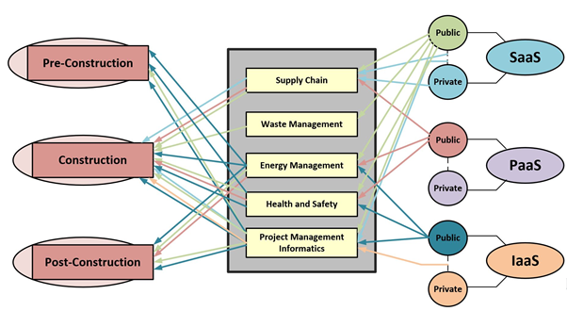
Use cases of Cloud Computing in Construction Industry

Slide 83
Use cases of Cloud Computing in Construction Industry

Slide 84
Cloud Computing for Construction Waste Minimisation
Uncoordinated construction management is characterised with untimely feedback that results in wastage of resources
Accumulating large inventories resulting in material wastage on site
Difficult to estimate wastage, project cost and time throughout the life cycle of a building
Limited accessibility to existing construction information has resulted in resources wastage
Precast construction - inaccurate components delivery, high cost of precast installation when contractor order changes, and lack of coordination among parties involved

Slide 85
Cloud Computing for Construction Waste Minimisation
Problem of accumulating large inventories resulting in material wastage on site
Solution → cloud-based technology employed to integrate suppliers and actual site demand

Slide 86
Cloud Computing for Construction Waste Minimisation
Wastage throughout the life cycle of a building must be minimised to reduce project cost and time over run
Solution → an efficient Cloud-BIM cost estimate process with simplified file structure that led to a substantial file space reduction that improves access for the design team

Slide 87
Cloud Computing for Construction Waste Minimisation
Limited accessibility to existing construction information has resulted in resources wastage
Solution → cloud computing used to reduce transaction costs and enhance online collaboration tools

Slide 88
Cloud Computing for Construction Waste Minimisation
The problem of lack of coordination among parties involved in the precast construction
Solution → a Cloud Computing Information System (CCIS) collaborative tool to improve productivity

Slide 89
Use cases of Cloud Computing in Construction Industry

Slide 90
Cloud Computing for Safe Construction
Construction sites are usually dangerous due to a large number of workers, materials, equipment, and dynamic/unforeseen circumstances
The risk of working in the construction site is further increased by a lack of access to real time safety information to provide predictive, quantitative, and qualitative measures allowing the identification, correlation, and elimination of hazards before health and safety incidents

Slide 91
Cloud Computing for Safe Construction
Building activities in construction sites are ineffectively monitored
Solution → a cloud-based information system for monitoring construction sites for improved safety with location information
Solution → a cloud-enabled platform to provide decision support tools to site managers and workers in on-site assembly process of prefabricated construction

Slide 92
Cloud Computing for Safe Construction
Existing manual construction-safety monitoring is labour-intensive and error-prone
Solution → a SaaS application to detect unsafe conditions and analyse the trajectories of workers with respect to potential safety hazards on construction site
Solution → cloud technology employed to observe the behaviour of workers during a metro construction to evolve a safety system
Solution → PaaS offering on a public cloud used to capture, process and share on-site safety data with location information

Slide 93
Cloud Computing for Safe Construction
Irregular and untimely site inspection
Solution → using the SaaS cloud with GPS for a Personalised Safety Instruction Method (PSIM) system

Slide 94
Cloud Computing for Safe Construction
The inaccurate collection and sharing of safety risks for underground construction
Solution → using cloud storage to achieve timely and accurate recognition of safety risk at the preconstruction stage of a project

Slide 95
Use cases of Cloud Computing in Construction Industry

Slide 96
Cloud Computing for Energy Management in Construction
Buildings consume appreciable amount of energy during both construction and operation stages

Slide 97
Cloud Computing for Energy Management in Construction
Realising green consumption
Solution → Cloud computing platform employed to manage construction information in building life cycle
Solution → IaaS, PaaS and SaaS cloud offerings employed to intelligently control building energy in smart cities
Solution → the SaaS cloud employed to propose an energy management system for sustainable decision support
Solution → IaaS and PaaS employed for hosting building data to realise Building Management Operation of green building

Slide 98
Cloud Computing for Energy Management in Construction
Affordable simulations design of energy efficient buildings
Solution → the computational power of cloud computing utilized to develop a Virtual Energy Laboratory
Solution → the SaaS cloud service employed to carry out the parametric simulation of the energy performance of a building within design processes of architectural and engineering practices

Slide 99
Cloud Computing for Energy Management in Construction
A unified interface for the diverse building management data integrated from disparate sources
Solution → A real-time energy awareness and an audit-style energy tracking system was implemented using the “linked data” technologies in a cloud environment

Slide 100
Use cases of Cloud Computing in Construction Industry

Slide 101
Cloud Computing in Supply Chain Management in Construction
The existing uncoordinated traditional material supply in construction site usually resulted in supply gap leading to delay in projects

Slide 102
Cloud Computing in Supply Chain Management in Construction
The unaffordability by SMEs of existing tracking systems
Solution → cloud platform-as-a-service technology employed to track material movement on construction site

Slide 103
Cloud Computing in Supply Chain Management in Construction
Increase visibility and traceability of materials and information flow in construction supply chain
Solution → a cloud-based cost-effective system integrated with RFID

Slide 104
Cloud Computing in Supply Chain Management in Construction
Miscommunications and improper transfer of information in a precast industry
Solution → cloud-based supply management system used o solve this problem

Slide 105
Cloud Computing in Supply Chain Management in Construction
For efficient construction process
Solution → the public and private SaaS cloud platform employed for interoperability bring together different stakeholders in the procurement process

Slide 106
Cloud Computing in Supply Chain Management in Construction
Accurate and relevant information to parties in the construction supply chain processes
Solution → the Context-Aware Cloud Computing Information Systems (CACCIS) developed

Slide 107
Cloud Computing in Supply Chain Management in Construction
Manage supply chain data in a cost-effective manner
Solution → used Google Fusion Table (GFT), Google Maps, and Google Earth

Slide 108
Use cases of Cloud Computing in Construction Industry

Slide 109
Cloud Computing for Project Management Informatics
The construction industry is characterised with communication and coordination problem culminating in low construction quality

Slide 110
Cloud Computing for Project Management Informatics
Cloud computing technology for collaborative design results in improved design, construction and project efficiency
The public SaaS cloud offering employed to formalize the transfer of knowledge among local construction companies to improve the construction project
Federated clouds employed to coordinate multi-site construction enabling varied individuals and organisations on multiple projects and in varied location to exchange information and data
"Clouds-for-Coordination"(C4C) architecture for improved security, reliance, fault tolerance and data access during construction
A cloud-based Design Process Communication Methodology (DPCM) for process clarity and information consistency resulting in fewer mistakes when data intensive construction processes are shared

Slide 111
Cloud Computing for Project Management Informatics
Data management
Cloud server instances employed to analyse data in order to predict failure of construction businesses
Cloud computing technology used to integrate real-time on-site information from PMIS, Web Camera, RFID, PDA used on site together with office work for rapid decision making
A data sharing capability using CometCloud (public and private) to store and manage building data, provide security during increasing demand and node failure
Hybrid environment for construction data management by SMEs using private grid and public cloud to automate complex workflows and optimise data transfer at a reduced cost
Project Data as a Service application supports all phase of data collection, automatic data correlation, intra/inter organisation data sharing and diachronic data tracing in a cost effective and efficient manner

Slide 112
Use cases of Cloud Computing in Construction Industry

Slide 113
Challenges of cloud adoption by construction industry

Slide 114
Challenges of cloud adoption by construction industry
Latency
Trust, Data Privacy and Security
Data Availability
Data Governance
Poor Broadband Connectivity of Construction Sites
Cost Implication of Long-Term Use
Dark Data
Threats of Edge Computing and Other Associated Technologies

Slide 115
Latency - problem
Cloud adoption in construction may not guarantee acceptable transfer rate and response time required for some time sensitive construction applications
This could either be a software issue or network problem

Slide 116
Latency - solutions
Proper software designing techniques have been known to prohibit latency issues, as the use of distributed cloud architecture can ensure that latency to a specific application is low
Cloud applications are recently designed to be cloud-native because cloud applications are known to scale well in cloud infrastructure
The use of hybrid cloud has also been employed to solve latency issues as delay-sensitive part of an application can be maintained in house while other part of the distributed application can be on the public cloud service
Construction Companies could also be linked to the service provider with dedicated link in order to prevent delay issues that could arise from the use of Internet as transport
Construction companies may also avert delay by choosing service providers with closer data centres as fewer hops between the service provider and the customer improves the network performance
There are Application Performance Monitoring (APM) tools monitoring network performance to enable early identification of the source of the latency problem and thus aid prompt solving of latency problems

Slide 117
Trust, Data Privacy and Security - problem
In practice, business partners are usually unwilling to give their private and commercial information such as project cost to a third-party
Storing construction design and financial information in shared resources understandably gives concern to construction industry
The perception is usually that some unknown set of people can access the stored data, this is more of a psychological discomfort
In reality the most sensitive part of the data chain resides with the client
Most data leakages from the cloud are from the client side, more so as employees are allowed to use own mobile devices for work
These own devices may be infected or even hacked

Slide 118
Trust, Data Privacy and Security - solution
Construction firms need to put up internal data protection strategies to block data leakage
However, in rare cases of data breach from service providers, data security and privacy laws could be invoked on cloud service providers to ensure compliance

Slide 119
Data Availability - problem
A cloud provider may shut down their resources unexpectedly
The building data becomes unavailable

Slide 120
Data Availability - solution
The cloud providers are known to provide 99.999% availability as stated in the Service Level Agreement
Create standards and strategies in data representations to enable various cloud providers to be compatible
This is to allow exchanging data between clouds providers to avoid the issue of lock-in if a provider became unavailable

Slide 121
Data Governance - problem
Construction projects involve many professionals
The issue of actual owner of data may arise, since all concerned party have access to the data and are required to update data continuously
Is the building owner allowed to share data with the engineer?

Slide 122
Data Governance - solution
There may be the need to define access level for the different category of stakeholders involve in the production and management of building data.
The applications shall implement appropriate access control features rather than leaving them to the cloud service provider

Slide 123
Poor Broadband Connectivity of Construction Sites - problem
Access to cloud services is primarily over the internet, hence, to maximise the benefit of cloud solution in the construction site, internet connectivity must be available every time
Project sites at times might be with low or no internet connectivity
Projects sites in underdeveloped area or a rural area
Projects that span larger geographical area with poor connectivity across the construction route - the power infrastructure projects
underground cabling
overhead lines
substations

Slide 124
Poor Broadband Connectivity of Construction Sites - solution
Further improvement in ICT technologies like the emergence of 5G network to connect rural communities and open up underdeveloped areas and thus boost the performance of cloud technology

Slide 125
Cost Implication of Long-Term Use - problem
Accumulated cost for the use of cloud infrastructure over a long period could be daunting, depending on the type of deployment
Meanwhile, the cost implication is not the same for the various cloud deployments types even for the same construction company
There could be substantial high cost of renting high-end resources such as GPUs for performing project analytics and machine learning tasks

Slide 126
Cost Implication of Long-Term Use - solution
Cloud SaaS pricing at inception was initially per unit time of consumption
It might be necessary for individual construction company to perform personalised cost analysis of long-term use of the various cloud deployment models before moving into cloud

Slide 127
Dark Data - problem
Dark data are data that are acquired but are not further processed or analysed for any meaningful insight
A large percentage of data generated by sensors never get used because most of the times the generation capacities is far greater than the analytics capacities
Most of the times most data collected are to satisfy regulatory policies
High cost of storing dark data
Storage fee cost
The energy consumed in storing and maintaining dark data

Slide 128
Threats of Edge Computing and Other Associated Technologies - problem
Some construction applications characterised with fast processing and quick response time may not be able to rely on the distant and centralised cloud computing

Slide 129
Threats of Edge Computing and Other Associated Technologies - solution
The need to bring processing nearer to devices has culminated into the emergence of Edge Computing and related technologies
Fog computing
Cloudlet
Hierarchical cloud computing
Mobile edge computing
Mobile IoT
Edge computing locates processing power near the source of the data generating devices, thus bringing services and utilities of cloud computing closer to the end users
The conventional centralised cloud continues to be relevant even as other technologies emerge
some applications are better suited for the centralised cloud while some are better carried out at the edge

Slide 130
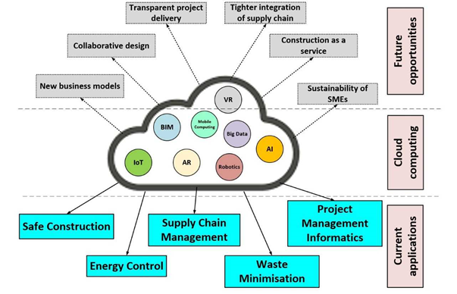
Summary

